Slide 1
Real Estate Project
Raghav Gupta

Slide 2
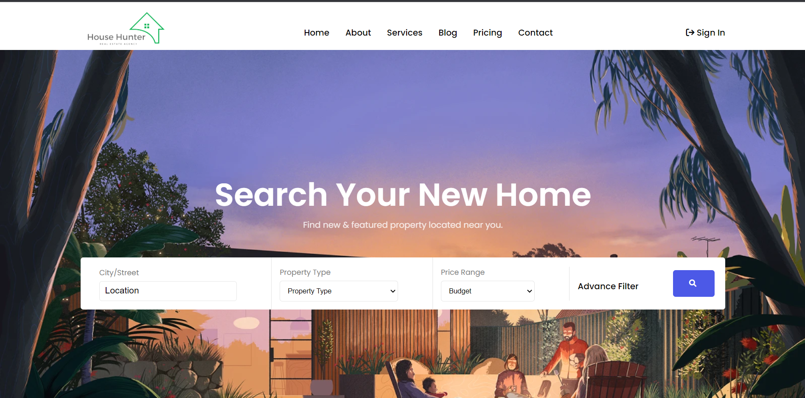
House Hunter – Main Page
In main page I have created navbar. In navbar I have taken a data.js file in which all of my data is present which is included in navbar as a form of array. Then I have imported that data in my navbar.jsx file using map function.

Slide 3
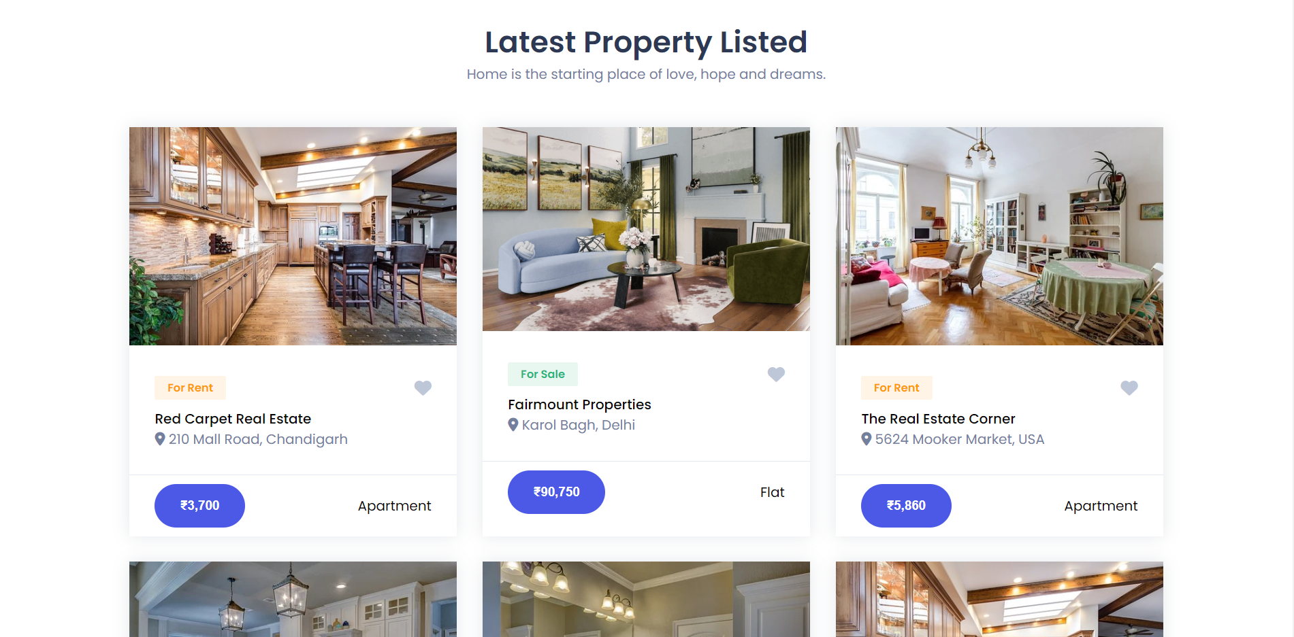
House Hunter - Properties
In properties page I have created various properties cards. In properties page I have taken a data.js file in which all of my data is present which is included in properties card as a form of array. Then I have imported that data in my properties.jsx file using map function.

Slide 4
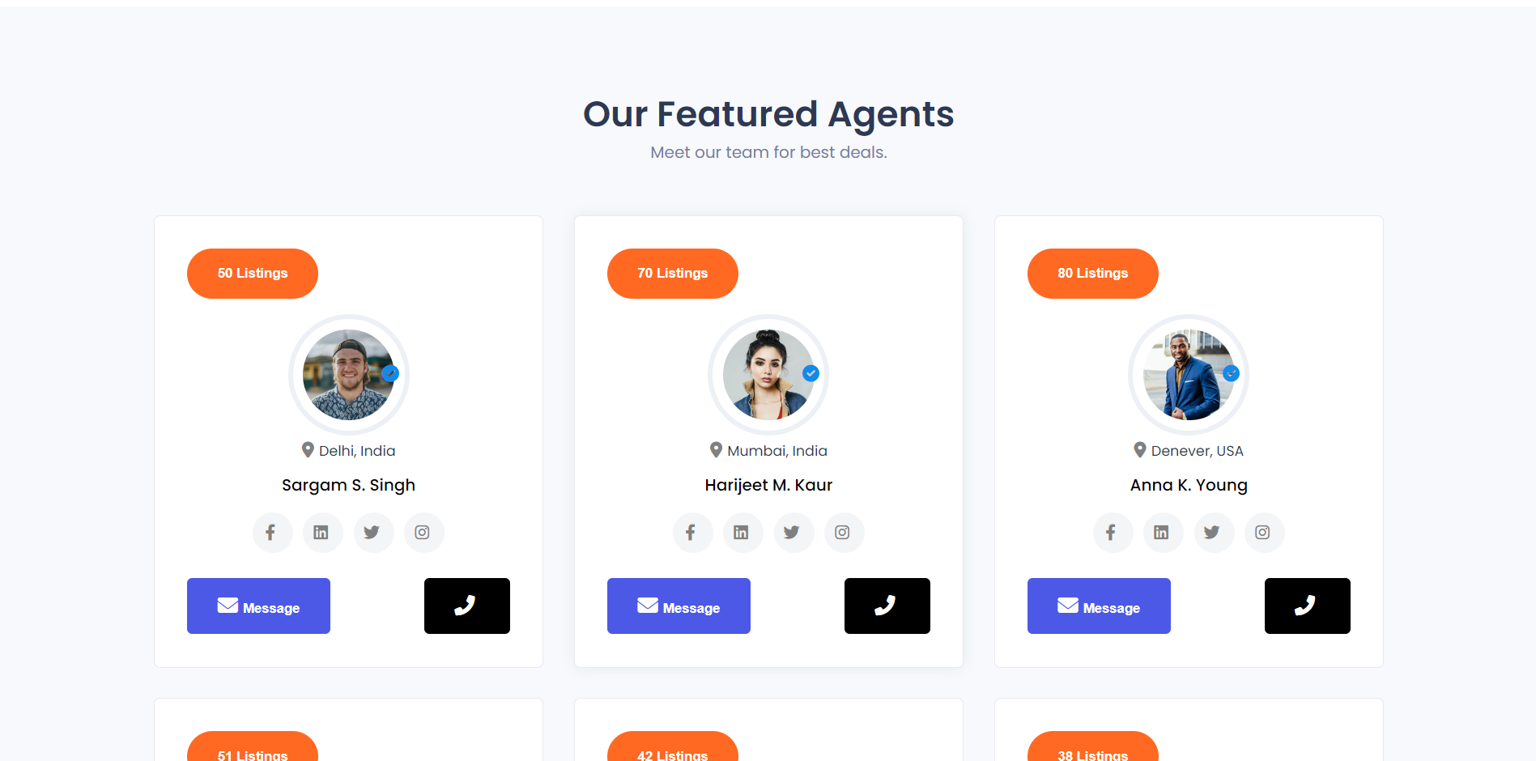
House Hunter - Agents
In agents page I have created various agents cards. In agents page I have taken a data.js file in which all of my data is present which is included in agents card as a form of array. Then I have imported that data in my agents.jsx file using map function.

Slide 5
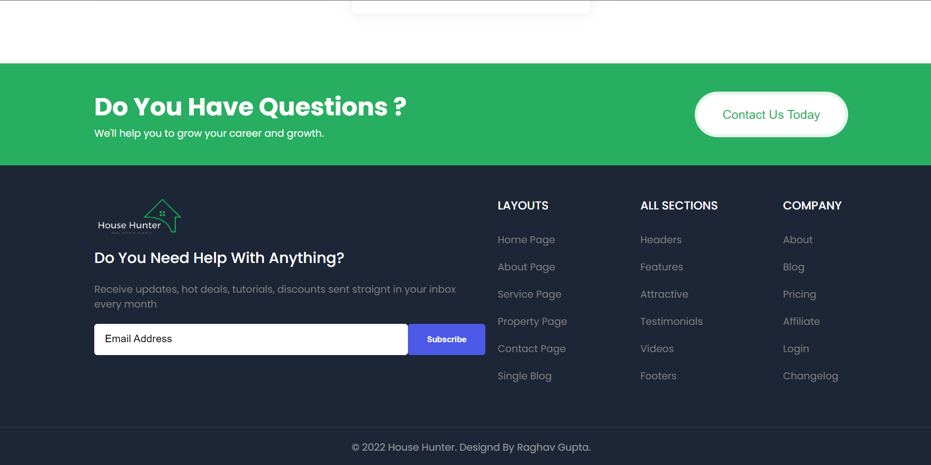
House Hunter - Footer
In footer page I have created various footer links. In footer page I have taken a data.js file in which all of my data is present which is included in footer card as a form of array. Then I have imported that data in my footer.jsx file using map function.

Slide 6

House Hunter – About Page
In about page I have created components and make them display in my about page.

Slide 7
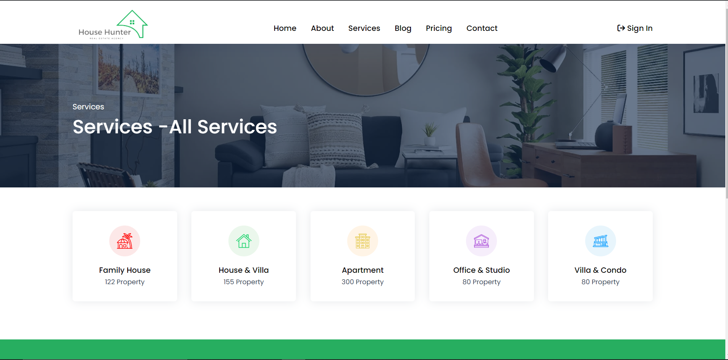
House Hunter – Services Page
In services page I have created components images simply and make them display in my service page.

Slide 8
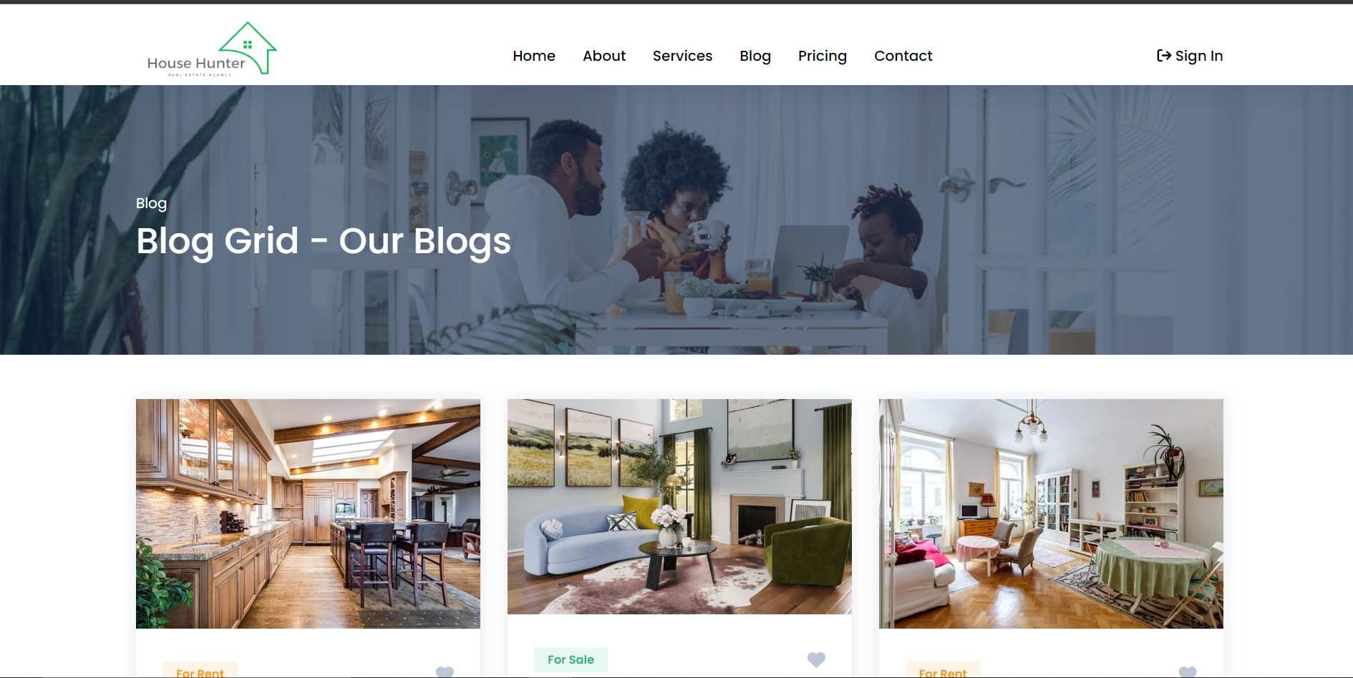
House Hunter – Blog Page
In blog page I have created various blog cards. In blog page I have taken a data.js file in which all of my data is present which is included in blog card as a form of array. Then I have imported that data in my blog.jsx file using map function.

Slide 9
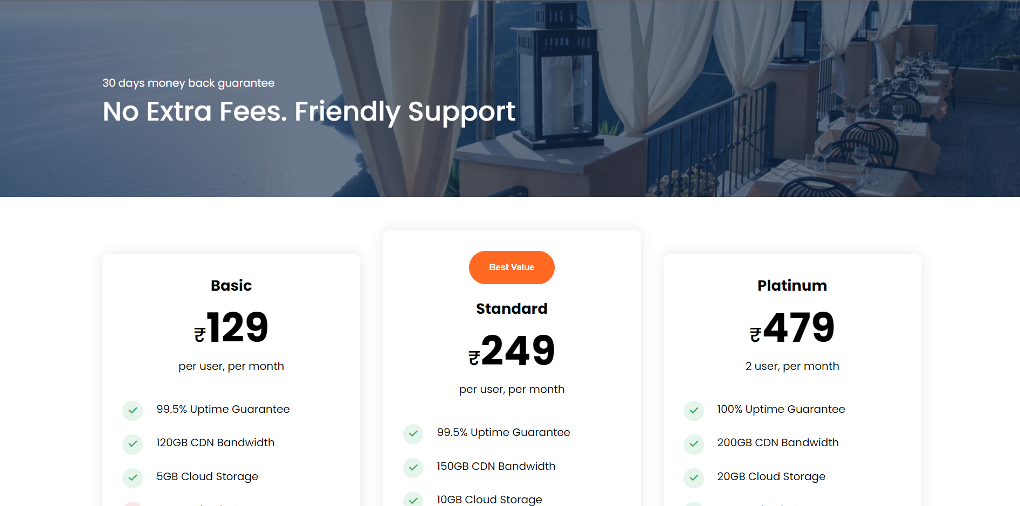
House Hunter – Pricing Page
In pricing page I have created various pricing cards. In pricing page I have taken a data.js file in which all of my data is present which is included in pricing card as a form of array. Then I have imported that data in my pricing.jsx file using map function.

Slide 10
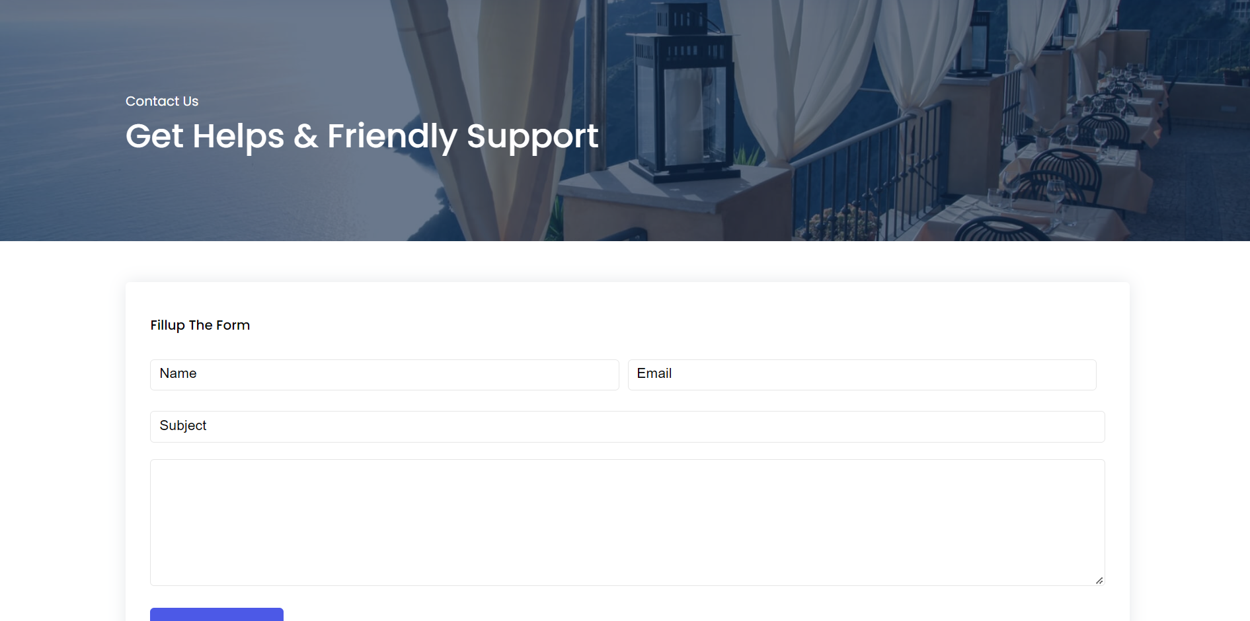
House Hunter – Contact Page
In contact page I have created a simple form which take name , email. And some area where user can write his/ her views and a a submit button.

Slide 11
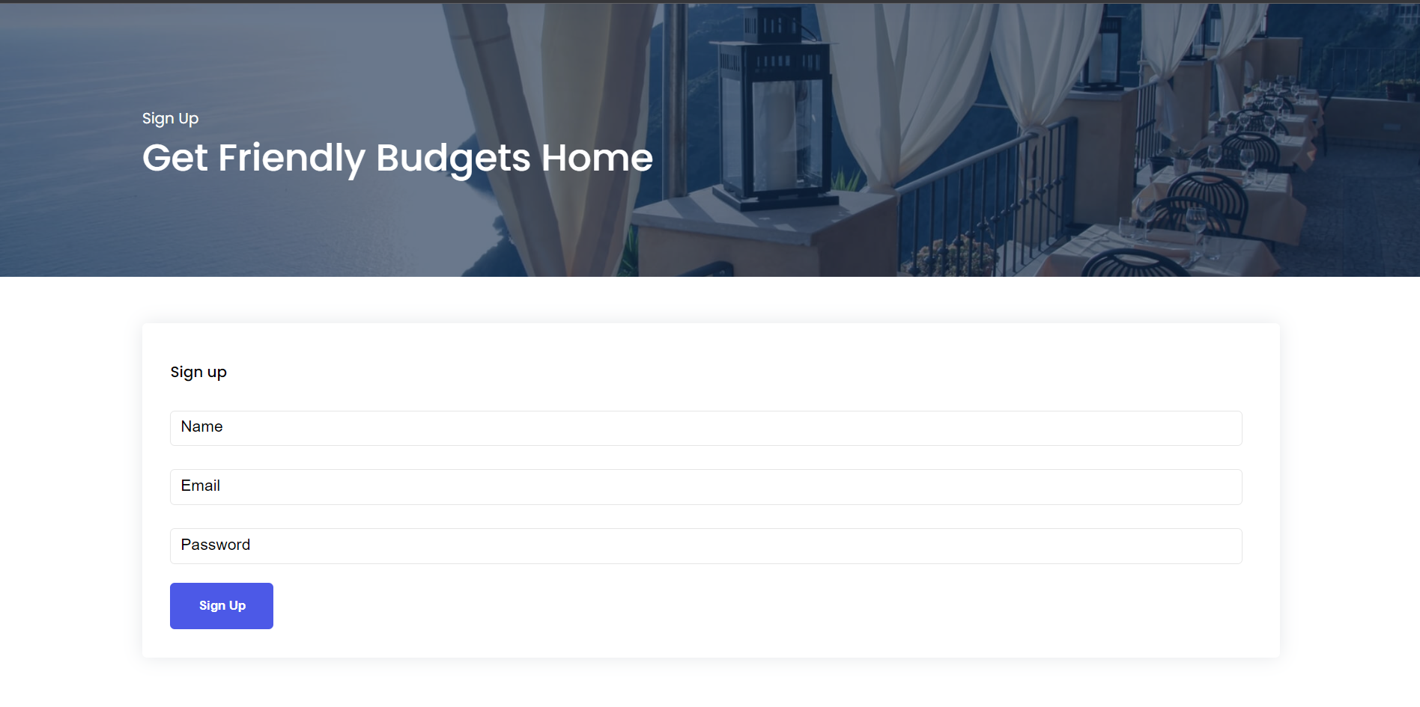
House Hunter – Sign in Page
In sign in page I have created a simple form which take user name , email and password and make user name display on the page where we have our sign in button

Slide 12
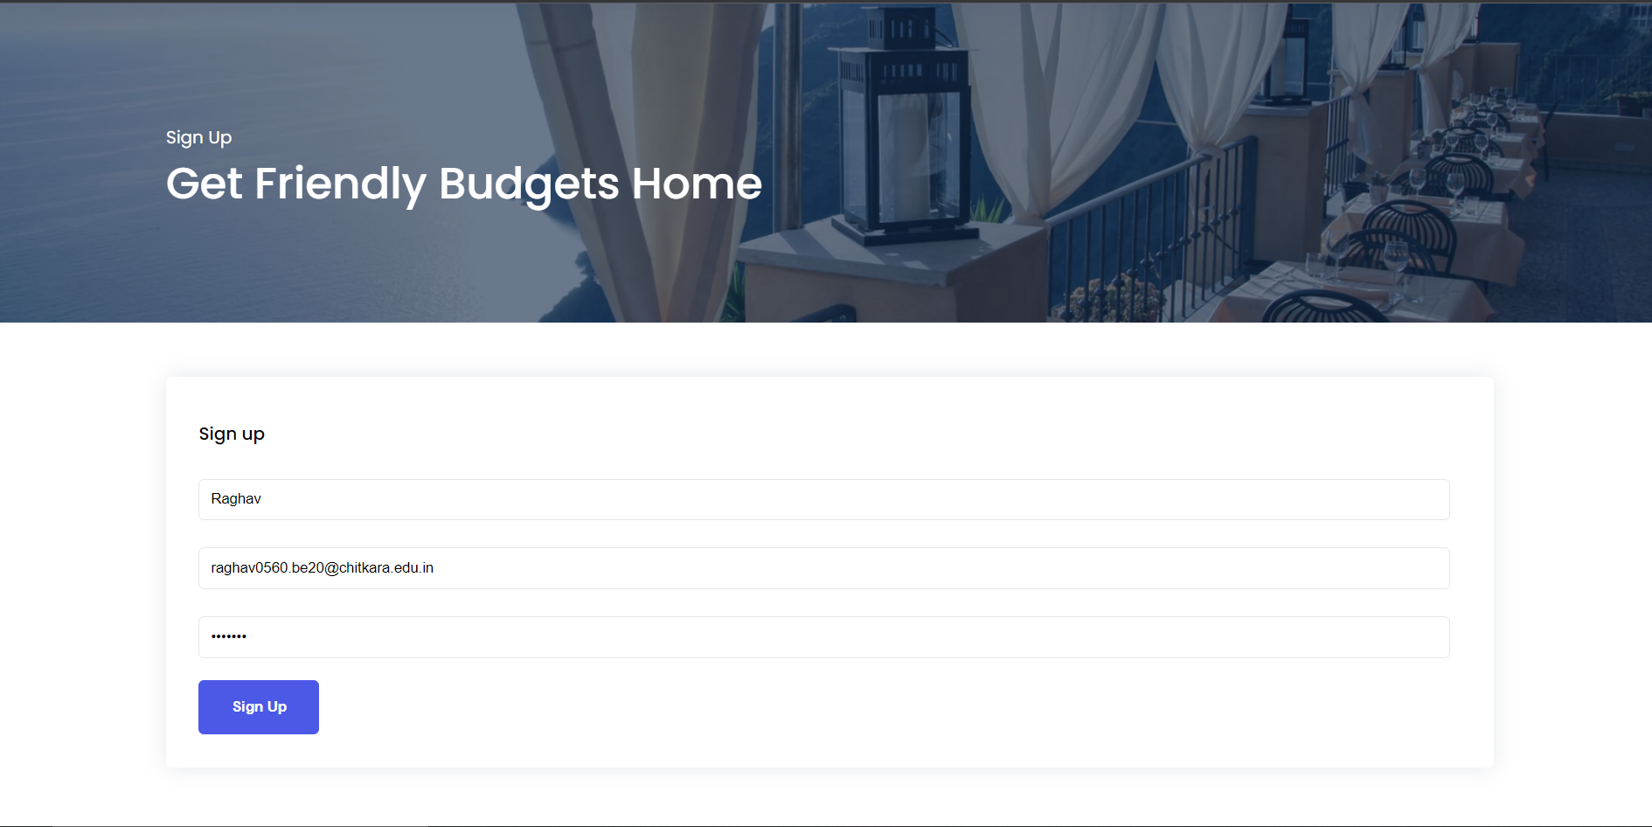
House Hunter – Sign in Page
I have filled my details. Now name will be came instead of sign in.

Slide 13
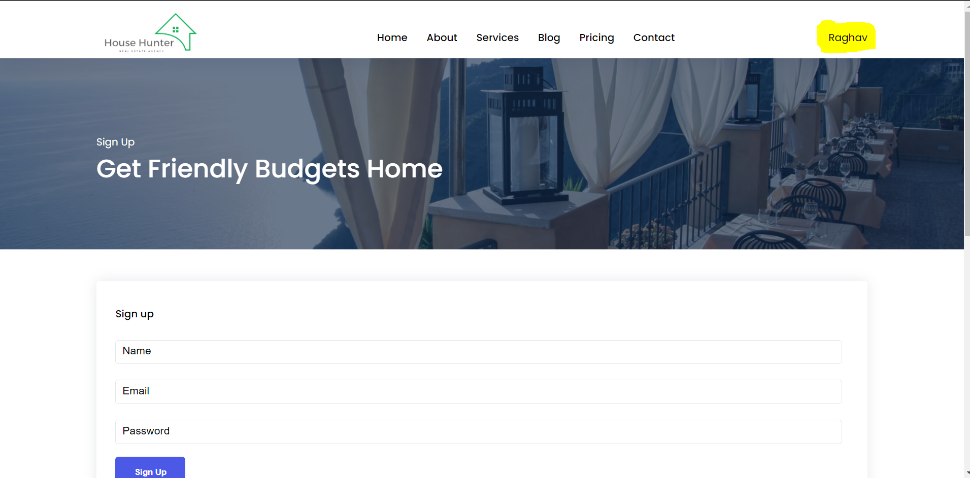
House Hunter – Sign in Page
Here it is as highlighted and details can be changed.

Slide 14
Thanks & Regards

